Slide 1
The Uncapacitated Facility Location LP rounding
Teammates:
Siri Verma : 180050052
Muthyala Leela Sri Pragna : 180050064
Vineetha Vennela : 180050118

Slide 2
Outline
Problem statement
Linear Programming relaxation
Dual of linear Programming relaxation
Intuition for the dual
Defining Neighbouring Facilities
Bounds on Assignment and Facility costs
Defining Neighbouring Clients of Neighbouring Facilities
Deterministic rounding Algorithm
4-approximation performance proof

Slide 3
Problem Statement
Given a set of clients D and set of facilities F, with facility costs f_{i} for all facilities i ∈ F and assignment costs c_{i j} for all facilities i ∈ F and clients j ∈ D.
The goal of the problem is to choose a subset of facilities F’ ∈ F to open and assign all the clients to the nearest facility in F’
So that the total cost of the open facilities and the assignment costs is minimum.
Notes:
uncapacitated : no limit on the number of clients assigned to a facility.

Slide 4
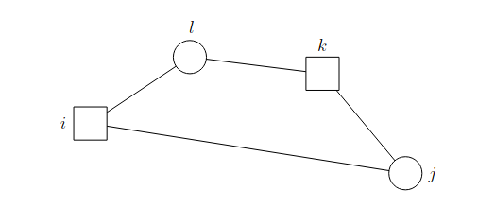
Assumption of the problem
We consider the metric uncapacitated facility location and assume that the clients and facilities are points in a metric space
The assignment cost c_{i j} represents the distance between client j and facility i and it obeys the triangle inequality.
Given clients j,l and facilities i,k , we have
c_{i j} ≤ c_{i l} + c_{k l} + c_{k j}

Slide 5
Linear Programming Relaxation
Minimize ∑_{(i ∈ F)} f_{i}*y_{i} + ∑_{(i ∈ F, j ∈ D)} c_{i j}*x_{i j}
Subject to
∑_{(i ∈ F)} x_{i j} = 1 ∀ j ∈ D
x_{i j} ≤ y_{i} ∀ i ∈ F, j ∈ D
x_{i j} ≥ 0 ∀ i ∈ F, j ∈ D
y_{i} ≥ 0 ∀ i ∈ F
x_{i j} denotes whether client j is assigned to facility i
y_{i} indicates whether facility i is open or not

Slide 6
Dual of Linear Programming Relaxation
Maximize ∑_{(j ∈ D)} v_{j}
Subject to
∑_{(j ∈ D)} w_{i j} ≤ f_{i} ∀ i ∈ F
v_{j} - w_{i j} ≤ c_{i j} ∀ i ∈ F, j ∈ D
w_{i j} ≥ 0 ∀ i ∈ F, j ∈ D

Slide 7
Intuition for the Dual
We can view v_{j} to be the amount that each client j will pay towards its part of the cost of the solution
The cost f_{i} for each facility is split into cost shares w_{i j} apportioned among the clients. A client j only needs to pay this share w_{i j} if it uses the facility i.
With the situation that all (explicit) facility costs are zero, the optimal solution is to assign each client to the facility where the net cost is minimum.

Slide 8
Intuition for the Dual
Each client j is to pay the lowest cost over all facilities of it’s services cost (c_{i}) and it’s share of the facility cost (w_{i j}).
By the second constraint in dual v_{j} - w_{i j} ≤ c_{i j} ∀i ∈ F, j ∈ D, v_{j} = min_{(i ∈ F)} (c_{i j} + w_{i j}).
As the dual is the maximizing problem, this forces v_{j} to be the smallest right-hand side over all facilities i ∈ F
Any feasible solution to the dual is a lower bound on the cost of an optimal solution of the facility location problem.

Slide 9
Neighboring Facilities
Lemma
Given an LP Solution x*, we say that facility i is neighbor of client j if x*_{i j} > 0.
N(j) = { i ∊ F : x*_{i j} > 0 } , where N(j) is neighbors of client j
If (x*, y*) is an optimal solution to the facility location LP and (v*, w*) is an optimal solution to its dual, then x*_{i j} > 0 implies c_{i j} ≤ v*_{j}
Proof :
By complementary slackness condition , x*_{i j} > 0 implies v*_{j} - w*_{i j} = c_{i j}
Since w*_{i j} ≥ 0 , we have c_{i j} ≤ v*_{j}

Slide 10
Bounds on Assignment costs
If we open a set of facilities S such such that for all clients j∈ D, there exists an open facility i ∈ N(j)
Then cost of assigning client j to facility i is no more than v*_{j} by the Lemma in previous slide
Thus the total assignment cost is no more than
∑_{(j ∈ D )} v*_{j} ≤ OPT
However, we cannot guarantee that we can have good facility cost, because there can exist a set of facilities S that can have very high facility cost

Slide 11


Bounds on Facility costs
The idea is to partition some subset F’ of F into set of facilities F_{k} such that F_{k} = N( j_{k}) for some client j_{k}.
Now, we open the cheapest facility i_{k} in N( j_{k})
We can bound the facility cost of i_{k} by
The equality is followed by the LP constraint
∑_{i ∊ F} x_{i j} = 1 ∀ j ∊ D
The inequality is followed as is the cheapest facility in F_{k}

Slide 12

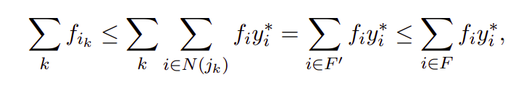

Bounds on Facility costs
Now by the LP constraint x_{i j} ≤ y_{i} , we see that
If we sum this inequality over all facilities that we open, then we get

Slide 13
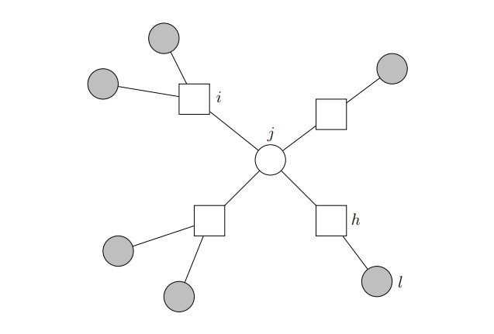
Definition of Neighbouring clients
Let N²( j) denote all neighboring clients of the neighboring facilities of client j
N²( j) = { k ∊ D : client k neighbors some facility i ∊ N( j) }

Slide 14
Deterministic Rounding Algorithm
Solve LP, get optimal primal solution (x*, y*) and dual solution (v*, w*)
C ← D
K ← 0
while C != Ø do
k ← k+1
Choose j_{k} ∊ C that minimizes v*_{j} over all j ∊ C
Choose i_{k} ∊ N( j_{k}) to be the cheapest facility in N( j_{k})
Assign j_{k} and all unassigned clients in N²(j_{k}) to i_{k}
C ← C - { j_{k}} - N²( j_{k})

Slide 15
Performance of the algorithm
Theorem: The algorithm is a 4-approximation algorithm for the uncapacitated facility location problem.
Proof:
Let’s consider just the total facility opening cost C_{F} first
C_{F} =
We can bound this cost,
C_{F} ≤ OPT

Slide 16
Now let’s consider the total assignment cost C_{A} ,
For an Iteration k, let j = j_{K} and i = i_{K},
The cost of assigning j to i is c_{i j} ≤ v_{j}*
The cost of assigning the unassigned client l ∊ N²(j) to i is
c_{i l} ≤ c_{i j} + c_{k j} + c_{k l} ≤ v_{j}* + v_{j}* + v_{l}*
c_{i l} ≤ 2v_{j}* + v_{l}*
c_{i l} ≤ 3v_{l}* ( We know v_{j}* ≤ v_{l}* )

Slide 17
Performance of the algorithm
Hence each client is connected with cost no worse than 3v_{j}*, so the total assignment cost is bounded
C_{A} = ∑_{( j ∈ D)} 3v_{j}* <= 3*OPT ( by weak duality)
C_{A} ≤ 3*OPT
The total cost is therefore C_{F} + C_{A} <= OPT + 3*OPT
<= 4*OPT

Slide 18
Improvements
When considering facility location costs, we bounded the opening cost of the linear program C_{F} with OPT , which seems rather wasteful
There are some randomized algorithms like Random rounding which gives better result (3-approx) than the LP rounding (4-approx) algorithm.

Slide 19
References
https://www.designofapproxalgs.com/book.pdf Section 4.5
https://ugtcs.berkeley.edu/src/approx-sp19/scribe-notes-6.pdf
https://www.cs.jhu.edu/~mdinitz/classes/ApproxAlgorithms/Spring2015/notes/lec10.pdf

Slide 20
Thank You

